Slide 1
Schedule
1:00 – 1:40 class time
10 minutes break
1:50 – 2:30 class time
10 minutes break
2:40 – 3:00 class time

Slide 2
Lecture 1: Python Basics
https://github.com/bigbrainacademy/python4kids
https://github.com/bigbrainacademy/python4kids

Slide 3
Computer
CPU: central processing unit
Ram: Random-access memory
HDD: hard disk drives
CD: Compact Disc

Slide 4
How to communicate with computer
What are you talking about?
I cannot understand.
Hi! Could you make a video game for me?

Slide 5
How to communicate with computer
Can you speak “Python” language?
Sure! I am learning Python now.

Slide 6
What’s python?
a powerful, high-level programming language.
easy (for kids) to learn, easy-to-read, without a lot of experience.
becoming more and more popular.
one of the top 10 programming languages.
provides real skills for the future.

Slide 7
What is Programming?
A program is a detailed set of instructions telling a computer exactly what to do.
There are many different programming languages.
Java
C/C++/C#
Python
Javascript
Python can be used in lots of ways:
Building websites
Programming robots
Scientific computing
Games

Slide 8
What are you going to learn?
You will learn
how to solve problems using code.
how to use turtle to draw funny shapes on the computer screen.
how to create simple games like Turtle race, Guess a Number, Rock-Paper-Scissors, and Pong.
Many more …

Slide 9
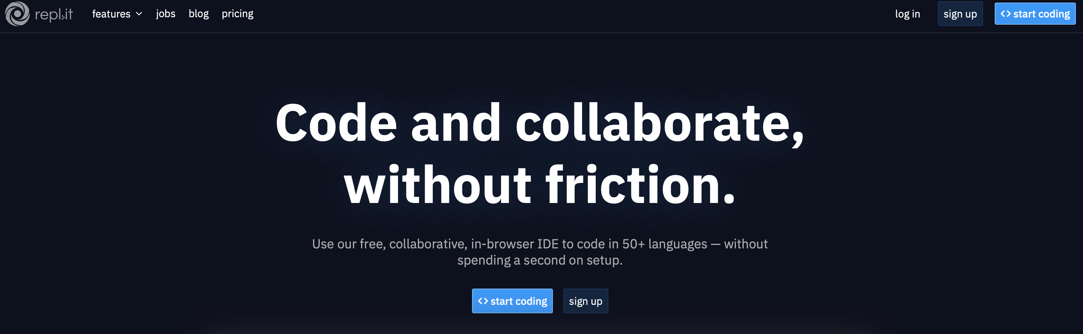
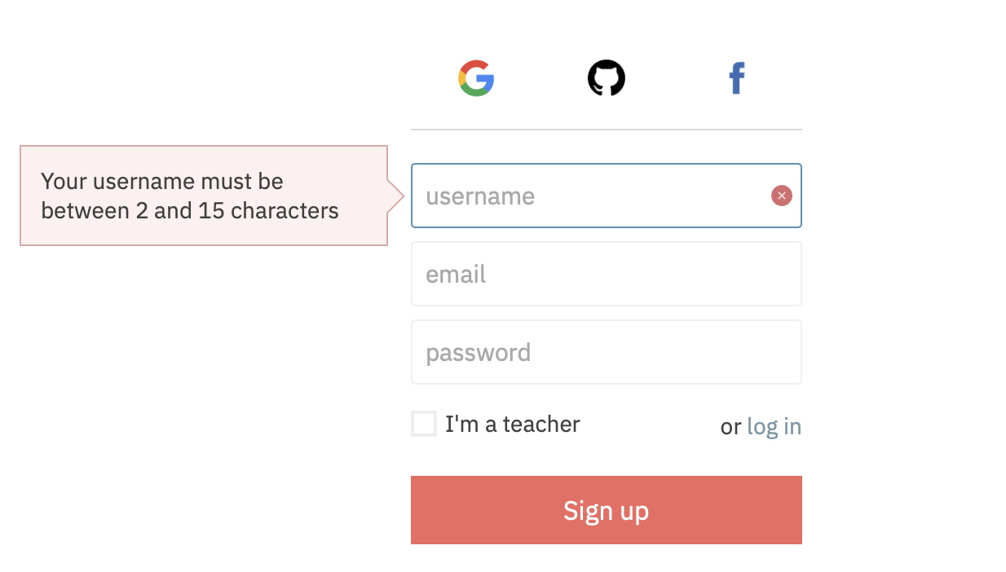
Set up an account on repl.it
Step 1: go to https://repl.it
Step 2: sign up
Ask your parents for help if you don’t have an email address
Remember/write down username and password

Slide 10
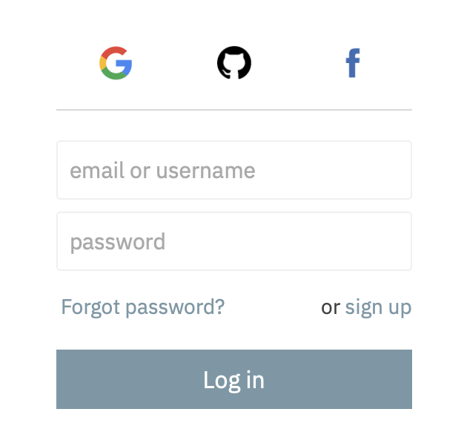
Set up an account on repl.it
Step 1: go to https://repl.it
Step 2: sign up
Step 3: log in

Slide 11
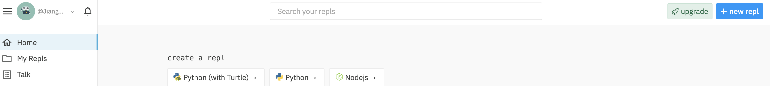
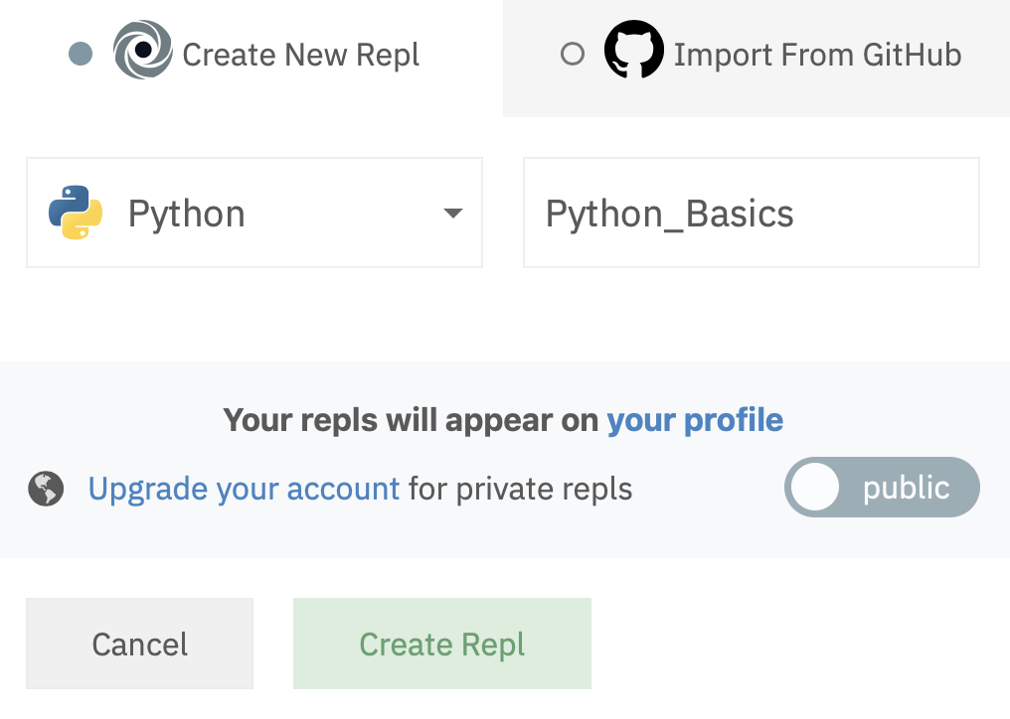
Run our code on repl.it

Slide 12
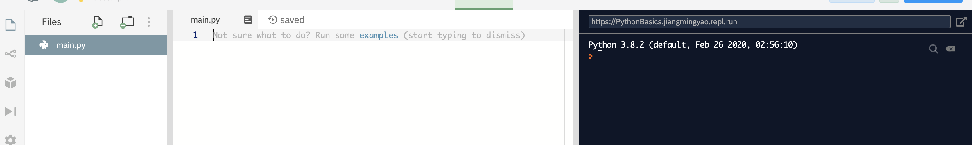
Run our code on repl.it
Congratulation!

Slide 13
String
Try this out!
String: surrounded by either single quotation marks, or double quotation marks.
Example:
'hello' or "hello"
Print: print out (the value of a string) on screen.
print("Hello world")
print("Congrats!")
Question: which one is NOT a string?
1) I am a string
2) “I am a string”
3) ‘I am a string’

Slide 14
Input() method
Try this out!
Input() method is a function that asks the user for input.
name = input("What’s your name? \n")
print("Hello", name)
string4age = input("How old are you? \n")
age = int(string4age)
print("Next year you will be", age + 1)
What’s your name?
Superman
Hello, Superman

Slide 15
Comments
Try this out!
Comments start with a hash mark (#), and Python will ignore them
print("Hello, World!") #This is a comment
- used to explain Python code.
- used to make the code more readable.
- used to prevent execution when testing code.
x = 5 # x is 5
y = 3 # y is 3
z = x + y # sum of x and y
print(z) # print out sum of x and y

Slide 16
Multi line Comments
#This is a comment #written in #more than just one line print("Hello, World!")
- To add a multiline comment you could insert a # for each line
""" This is a comment written in more than just one line """ print("Hello, World!")
- Or add a multiline string (triple quotes) in your code, and place your comment inside it

